Slide 1

CipherCop 2025
"Spot the Fake: AI-PowERED DETECTION OF FRAUDULENT WEBSITES, APPS & DIGITAL CONTENT"
TEAM MEMBERS : DIPANSHU BHARATIA , NISHAL SHAH, HARSH SHUKLA

Slide 2


PROBLEM STATEMENT
Develop an AI/ML-based system that can automatically detect, classify, and flag fraudulent online content—including fake websites, scam mobile applications, phishing domains, or app clones. The system should leverage publicly available data (e.g., WHOIS, app metadata, DNS patterns, UI similarity) and use supervised or unsupervised models to classify content as genuine or suspicious.

Slide 3
PROPOSED WORK
Real-Time Fraud Detection: Develop an AI-powered system to instantly detect, classify, and flag fraudulent online content, including websites, apps, and phishing domains.
Multi-Platform Protection: Create a seamless Chrome extension for web browsing and a dedicated analyzer to inspect Android applications (.apk files) for malicious code and cloning.
Intelligent Classification & User Safety: Deliver a clear "Genuine" or "Suspicious" verdict on digital content, empowering users to make safe online decisions and navigate with confidence.

Slide 4
TECHNOLOGY STACK
Frontend: Chrome Extension (JavaScript, HTML, CSS)
Backend: Python (Flask)
Machine Learning: Scikit-learn, TensorFlow (Deep Learning & Ensemble Models), NLP Toolkit.
Data Sources & Libraries: WHOIS API, DNS Query Libraries, Python for network analysis, Image Processing for UI checks, Kaggle.

Slide 5

DATA USED
Android Malware: Contains network logs from malicious Android apps, teaching our model to recognize the unique digital footprints of mobile threats. (Source : Kaggle)
Dataset Phishing: A comprehensive collection of network logs from known phishing sites, crucial for training our system to spot fraudulent website behavior. (Source : Kaggle)
Webpages Classification: Allows our model to learn from the content of webpages, enabling it to detect scams based on text and structure, not just network activity. (Source : Kaggle)

Slide 6
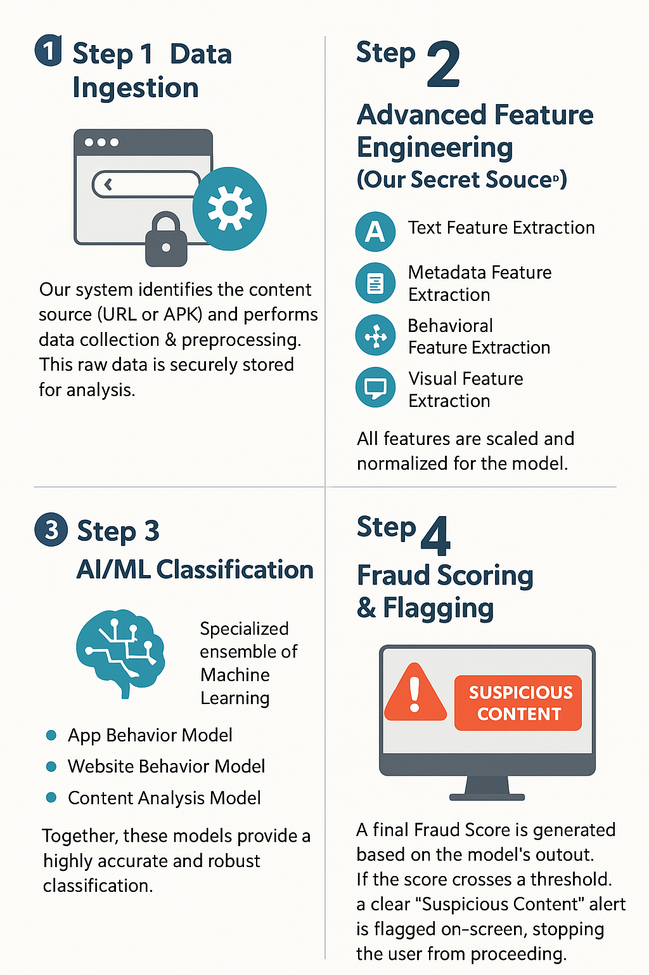
HOW IT WORKS

Slide 7
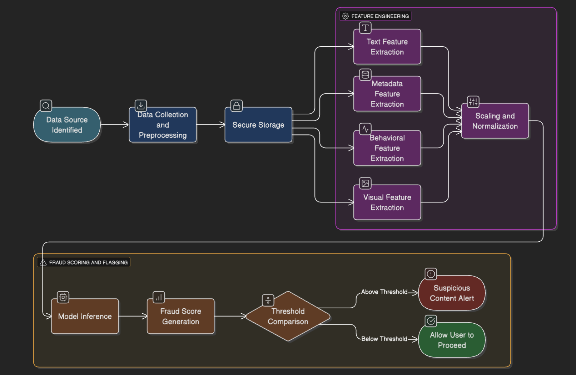
SYSTEM
FLOW

Slide 8


USEFULNESS OF SYSTEM
Comprehensive Analysis: We leverage multiple public data sources (WHOIS, DNS, etc.) and feature types, from text to visuals.
Zero-Day Protection: By analyzing behavior, we identify brand-new threats not on any blacklist.
Fully Automated: The system detects, classifies, and flags content with zero user effort.

Slide 9

THANK YOU

